Slide 1
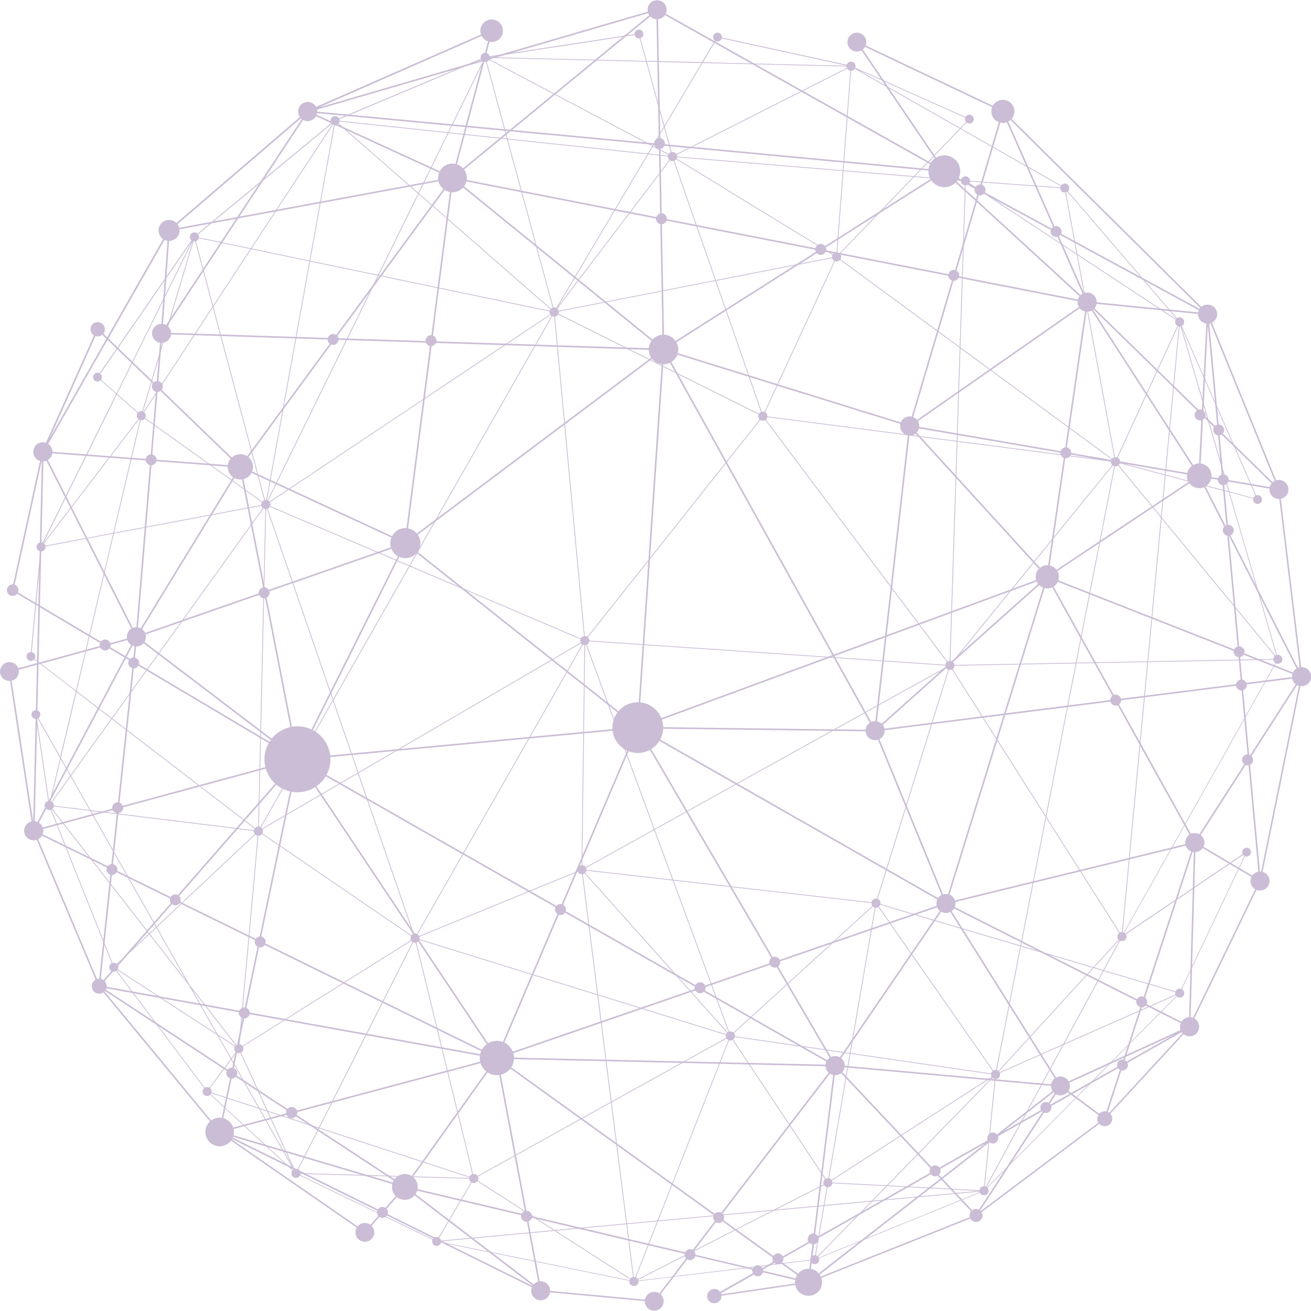



Enhancing Citizen Engagement and Trust in Smart City Governance
Jelena Stanković, Vladislav Marjanović, Ivana Marjanović, Branko Krsmanović, Aleksandar Stamenković
3rd SARSA Annual Conference, 10-12 September 2025, University of Cape Town, South Africa

Slide 2



Introduction
• Citizens are central to city sustainability and prosperity.
• Active participation enhances governance responsiveness.
• Challenges: scandals, corruption, inequality.
• Smart governance provides opportunities for transparency and inclusivity.

Slide 3
Objectives
• Analyse effectiveness of 'City and Me' app.
• Explore how digital tools:
– Facilitate citizen-driven governance
– Strengthen transparency
– Build trust in public administration

Slide 4
Theoretical Foundations
• Arnstein’s Ladder of Participation – moving from tokenism to genuine influence.
• New Public Service (NPS) – citizens as partners, not customers.
• Ostrom’s Collective Action Principles – co-creation of governance solutions.

Slide 5
Methodology
• Exploratory case study – City and Me app.
• Mixed methods: surveys, descriptive & inferential statistics.
• Blockchain-enabled feedback for transparency.
• Study conducted in Niš, Serbia (17,345 invited, 1,231 respondents).

Slide 6
Results
• Strong participation: 7.1% response rate.
• Majority respondents: under 35 years old.
• Main concerns:
– Cleanliness & maintenance
– More greenery & aesthetics
– Safety and lighting
– New amenities (playgrounds, fitness).

Slide 7
Discussion
• City and Me fosters inclusive and transparent governance.
• Digital tools enhance trust through transparency and accountability.
• Younger demographics more engaged – digital divide persists.
• Importance of continuous feedback loops.

Slide 8
Conclusion
• Citizen participation is essential in smart governance.
• Digital platforms enable actionable feedback and transparency.
• City and Me demonstrates effectiveness in enhancing trust.
• Policy implications: expand digital literacy, refine participatory tools, embed citizen input.

Slide 9
Thank You!
www.urwise.net

